Slide 1
The Day of Resurrection
The Minor Signs
Do they then await (anything) other than the Hour, that it should come upon them suddenly? But some of its portents (indications and signs) have already come, and when it (actually) is on them, how can they benefit then by their reminder?
(Muhammad 47:18)

Slide 2
Why do we need to learn about these signs?
The signs leading up to the Day of Judgment is knowledge that has been transmitted since the earliest prophets, as a warning to mankind; a warning that this life is not the end, but that there exists a hereafter in which we will be held accountable for our deeds in this world. It is this accountability piece that has caused mankind to be responsible and mature about the way that he/she chooses to live their lives. Furthermore, because of the fascinating aspect of this topic, this knowledge has been preserved and will continue to, so that the later generations will continue to prepare and be prepared when this Day dawns upon humanity.

Slide 3
When will the Day of Judgement come?
They ask you about the Hour (Day of Resurrection): "When will be its appointed time?" Say: "The knowledge thereof is with my Lord (Alone). None can reveal its time but He. Heavy is its burden through the heavens and the earth. It shall not come upon you except all of a sudden." They ask you as if you have a good knowledge of it. Say: "The knowledge thereof is with Allah (Alone) but most of mankind know not." (Al-A'raf 7:187)

Slide 4
When will the Day of Judgement come?
They ask you (O Muhammad) about the Hour, - when will be its appointed time? You have no knowledge to say anything about it. To your Lord belongs (the knowledge of) the term thereof? You (O Muhammad) are only a warner for those who fear it. The Day they see it, (it will be) as if they had not tarried (in this world) except an afternoon or a morning. (An-Nazi'at 79:42-46)

Slide 5
When will the Day of Judgement come?
The Prophet (saw) said: “There are five things which nobody knows except Allah;” then he recited, “Verily the knowledge of the Hour is with Allah (alone). It is He Who sends down rain, and He Who knows what is in the wombs. Nor does anyone know what it is that he will earn on the morrow: Nor does anyone know in what land he is to die. Verily with Allah is full knowledge and He is acquainted (with all things).” (Luqman 31:34) (Sahih Bukhari)

Slide 6
When will the Day of Judgement come?
From the above stated ayats and hadith, it is obvious then that no one knows when this Day will occur. However, its reality still plays an important role in our lives as is evident from this following encounter: A Bedouin asked the Prophet about the Hour. He said, “It will surely come to pass. What have you prepared for it?” The man said, “O Messenger of Allah, I have not prepared much in the way of prayer and good works, but I love Allah and His Messenger.” The Prophet said, “You will be with those you love.” The Muslims had never rejoiced as much they did when they heard this. (Sahih Muslim)

Slide 7
What are the Minor Signs?
The first minor sign regarding this Day is the Birth of the Last Prophet (saw): The Prophet (saw) said, whilst pointing with his index and middle fingers, “The time of my advent and the Hour are like these two fingers.” (Sahih Bukhari).

Slide 8
What are the Minor Signs?
The second minor sign is his death (saw): The Prophet (saw) said, “Count six signs that indicate the approach of the Hour – my death, the conquest of Bait-ul-Maqdis (Jerusalem), a plague that will afflict you and kill you in great numbers as the plague that afflicts sheep, the increase of wealth to such an extent that even if one is given one hundred Dinars he will not be satisfied, then an afflection which no Arab house will escape and then a truce between you and Bani al-Asfar (the Byzantines) who will betray you and attack you under eight flags, each flag will be carried by twelve thousand soldiers. (Sahih Bukhari)

Slide 9
What are the Minor Signs?
The third minor sign, mentioned in this hadith is the conquest of Masjid al-Aqsa in Jerusalem which occurred during the Caliphate of Umar ibn Al-Khattab in 16th A.H. It was again reclaimed in 583 A.H. by Salehaddin Ayyubi (after its loss in 492 A.H. during the first crusade, due to bickering among the Abbasite and Fatimite empires).

Slide 10
What are the Minor Signs?
The fourth minor sign mentioned above is the Plague, which did occur also during the Caliphate of Umar ibn Al-Khattab in 18 A.H. The area of Amwas, near Damascus in Syria, was devasted with the loss of 25, 000 lives.

Slide 11
What are the Minor Signs?
The fifth minor sign is the fact that wealth become in such abundance that people will have zakat money to give, but will not be able to find anyone to take it: The Prophet (saw) said, “Give charity for a time is to come when a person would walk with his zakat money and the one who is suppose to receive it will say, ‘I wish you had brought it yesterday so I could accept it, because today I do not need it.’ And the giver of the zakat will not find anyone to accept it.” (Sahih Muslim)

Slide 12
What are the Minor Signs?
The sixth minor sign, which is very significant among the minor signs, is the splitting of the moon – this incident has been recorded in the Qur’an: The Hour has drawn near, and the moon has been cleft asunder (the people of Makkah requested Prophet Muhammad SAW to show them a miracle, so he showed them the splitting of the moon). (Al-Qamar 54:1)
Abdullah Ibn Mas’ud relates, “While we were with the Messenger of Allah (saw) at Mina, the moon split into two parts. One part was above the mountain and one part was below it. The Messenger of Allah (saw) then said to us, ‘Bear Witness.’” (Bukhari & Muslim)
Anas ibn Malik said, “Verily the people of Makkah asked the Messenger of Allah (saw) to show them a sign and so twice he made them see the splitting of the moon.” (Bukhari and Muslim)

Slide 13
What are the Minor Signs?
This sign has caused some confusion because there appears to be no information regarding this astronomical event – but, in fact there is. The Chinese astronomers would NOT have recorded this event, opposite to the Orientalist philosophers claims, because China would have been experiencing daylight! But there is evidence in the following:

Slide 14
What are the Minor Signs?
The incident relating to King Chakrawati Farmas is documented in an old manuscript in the India Office Library, London, which has reference number: Arabic, 2807, 152-173. It is quoted in the book “Muhammad Rasulullah,” by M. Hamidullah:
“There is a very old tradition in Malabar, South-West Coast of India, that Chakrawati Farmas, one of their kings, had observed the splitting of the moon, the celebrated miracle of the Holy Prophet (pbuh) at Mecca, and learning on inquiry that there was a prediction of the coming of a Messenger of God from Arabia, he appointed his son as regent and set out to meet him. He embraced Islam at the hand of the Prophet, and when returning home, at the direction of the Prophet, died at the port of Zafar, Yemen, where the tomb of the “Indian king” was piously visited for many centuries.”

Slide 15
What are the Minor Signs?
The answer of Prof. Al-Najjar was limited to this incident, but one of the audience called David Mosa Pidcook (leader on British Muslim Party) asked to comment on this question and he said: It was shown in BBC a program where there was a debate between three experts. The discussion was about if the amount of money paid by NASA to send a human to land on the surface of the moon to study the inner structure of the moon was worth it or not?? The American government authorised a budget of $100, 000, 000, 000 (one hundred thousand million dollar) for this project.

Slide 16
What are the Minor Signs?
One of the discoveries of that project was that there is a layer of material that splits the moon into two halves and the only explanation to this discovery that the moon was split at some times in its history and rejoined.
http://www.muslimtents.com/muslimguide/Science1.htm
http://www.metacafe.com/watch/303737/moon_split_from_nasa/
http://antwrp.gsfc.nasa.gov/apod/ap021029.html
http://www.inblogs.net/culturelifesciencenews/2006/02/moon-nearly-split-in-two-4-billion.html

Slide 17
What are the Minor Signs?
The seventh minor sign is the Fire of the Hijaz – the Prophet (saw) said, “The Hour will not be established until a fire comes out in the land of the Hijaz, a fire that will illuminate the necks of the camels in Basrah.” (Bukhari and Muslim) This fire has already occurred; it started as an earthquake on the outskirts of Madinah in Jumada al-Akhir in the year 654 A.H. and was recorded by a number of Islamic scholars included Ibn Kathir.

Slide 18
What are the Minor Signs?
The eighth minor sign is the Embargo – the Prophet (saw) said, “Iraq will be denied its dirham and qafiz. Ash-Sham (Syria) will be denied its mudd and dinar. And Egypt will be denied its irdab and dinar. You will return to where you began. You will return to where you began.” (Muslim) Indeed, we have already seen the embargo on Iraq at the end of the first gulf war and the embargo on Egypt by the other Arab nations as well as the arms embargo on Egypt during the Suez Canal crisis. There is already a trades embargo on Syria by the U.N. and there is another embargo in the works by the U.S.
Qafiz, Mudd and Irdab are quantity measurements

Slide 19
What are the Minor Signs?
In the hadith of Jibreel, we find the next 3 minor signs:
Then he [Jibreel] said: 'Tell me about its signs'. The Prophet (saw) replied: 'That the slave girl will give birth to the free woman¹; that you shall see these bare footed, naked, and poor shepherds [of Arabia]² competing with each other in making high buildings'³.

Slide 20
What are the Minor Signs?
This seems to be a reference to the abolition of the institution of slavery. It refers to the time when a child born to a slave-girl would be a free person.
This is a reference to the prevalent poverty of the Arabs.
When the affluence of the then destitute Arabs would be manifested in their competing with each other in building sky scrapers –
  In the city of Riyadh, Saudi Arabia there are now 2 main towers (skyscrapers) called: Faisaliyah Tower and Mamlaka Tower. It was noted that the builders of Mamlaka Tower delayed completion of their building until the Faisaliyah was finished; then the Mamlaka tower was made taller! Lastly, 50 years ago the area of Riyadh was filled with tribes of bare footed, naked, and poor shepherds

Slide 21
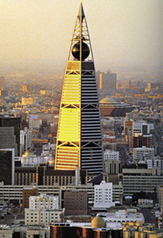
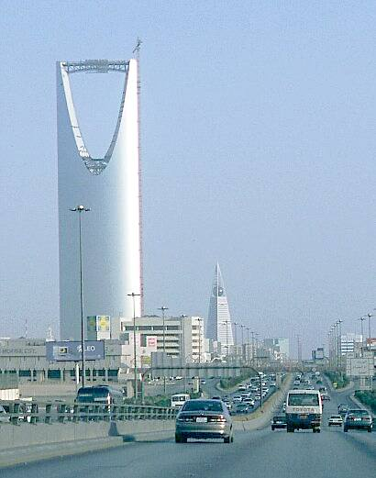
What are the Minor Signs?

Slide 22
What are the Minor Signs?
Minor signs twelve to fifteen are mentioned in the following hadith of the Prophet (saw), “Indeed, from the signs of the Hour is that there will be little [religious] knowledge and widespread ignorance [of Islam]; fornication will be rampant; alcohol will be consumed in great quantities; men will decrease in number and women will become plentiful, until there remains one male guardian for every fifty women. (Bukhari and Muslim)

Slide 23
What are the Minor Signs?
The sixteenth and seventeenth minor sign is tyranny and oppression (of oneself even) as the Prophet (saw) said, “There are two kinds of people of the Hellfire that I have not yet seen: a people who will have with them whips that are like the tails of cows and they will strike people with them – S&M – and women who are dressed yet naked [watch FashionTV lately?] who will walk with a strut, swinging their heads as they are walking. Their heads will be like the humps of leaning camels – they will not enter Paradise, nor will they smell it and the smell of it can be perceived from such and such a distance.” (Muslim)

Slide 24
What are the Minor Signs?
The eighteenth minor sign is that the ignorant will lead – the Prophet (saw) said, “Indeed, before the Hour there are deceptive years – the truthful one will not be believed, the liar will be believed; the trustworthy one will be accused of betrayal and the treacherous one will be trusted; and the Ruwaibidah will speak.” A companion asked, “What is Rwaibidah?” He (saw) replied, “The man who is stupid will speak on the affairs of the general public (he will be trusted to rule and he will speak in the name of the people). (Ahmad, Sahih)

Slide 25
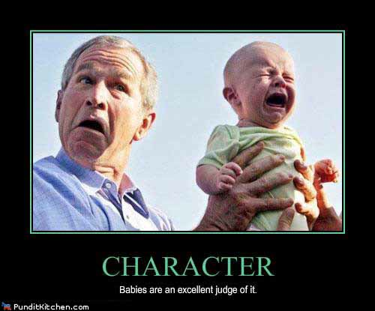
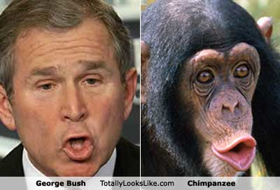
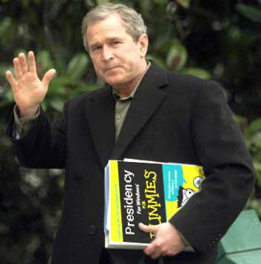
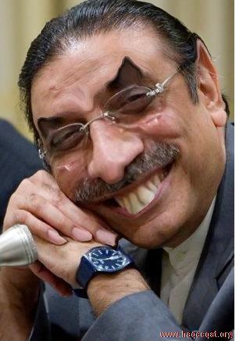

Slide 26
What are the Minor Signs?
The nineteenth minor sign is the death of our scholars, as the Prophet (saw) stated, “Verily Allah does not seize knowledge by force, taking it forcefully from the people; instead He takes away knowledge by the death of scholars until there remains no scholar. The people will then take ignorant leaders who will be asked and who will rule without knowledge. They are misguided and they will misguide others.” (Bukhari and Muslim)
In our recent times we have lost some giants among the scholars including: Shaykh Muqbil (2001), Sh. Al-Albani (1999), Shaykh Abdul-Aziz ibn Baaz (1999) and Shaykh Muhammad ibn Saleh Uthaimeen (2001)

Slide 27
What are the Minor Signs?
Of course, with the death of scholars is the spread of ignorance and division amongst the Muslims, which is minor sign number twenty: Hudhayfah ibn al-Yaman said, "People used to ask the Prophet (saw) about good things, but I used to ask him about bad things because I was afraid that they might overtake me. I said, 'O Messenger of Alla, we were lost in ignorance (Jahiliyyah) and evil, then Allah brought this good (i.e. Islâm). Will some evil come after this good thing?' He said, 'Yes' I asked, 'And will some good come after that evil?' He said, 'Yes, but it will be tainted with some evil' I asked, 'How will it be tainted?' He said, 'There will be some people who will lead others on a path different from mine. You will see good and bad in them." I asked, 'Will some evil come after that good?' He said, 'Some people will be standing and calling at the gates of Hell; whoever responds to their call, they will throw him into the Fire.' I said, 'O Messenger of Allah, describe them for us.' He said, 'They will be from our own people, and will speak our language.' I asked, 'What do you advise me to do if I should live to see that?' He said, 'Stick to the main body (jama'ah) of the Muslims and their leader (Imam). I asked, What if there is no main body and no leader?' He said 'Isolate yourself from all of these sects, even if you have to eat the roots of trees until death overcomes you while you are in that state.'" (Sahih Bukhari)

Slide 28
What are the Minor Signs?
Of course, with the death of scholars is the spread of ignorance and division amongst the Muslims, which is minor sign number twenty: Hudhayfah ibn al-Yaman said, "People used to ask the Prophet (saw) about good things, but I used to ask him about bad things because I was afraid that they might overtake me. I said, 'O Messenger of Alla, we were lost in ignorance (Jahiliyyah) and evil, then Allah brought this good (i.e. Islâm). Will some evil come after this good thing?' He said, 'Yes' I asked, 'And will some good come after that evil?' He said, 'Yes, but it will be tainted with some evil' I asked, 'How will it be tainted?' He said, 'There will be some people who will lead others on a path different from mine. You will see good and bad in them." I asked, 'Will some evil come after that good?' He said, 'Some people will be standing and calling at the gates of Hell; whoever responds to their call, they will throw him into the Fire.' I said, 'O Messenger of Allah, describe them for us.' He said, 'They will be from our own people, and will speak our language.' I asked, 'What do you advise me to do if I should live to see that?' He said, 'Stick to the main body (jama'ah) of the Muslims and their leader (Imam). I asked, What if there is no main body and no leader?' He said 'Isolate yourself from all of these sects, even if you have to eat the roots of trees until death overcomes you while you are in that state.'" (Sahih Bukhari)

